Slide 1


Slide 2

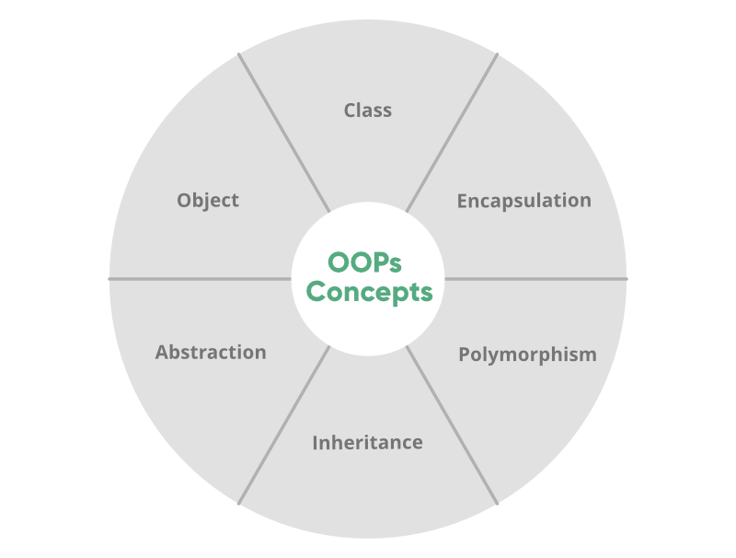
Object-oriented programming aims to implement real-world entities like inheritance, hiding, polymorphism, etc in programming.
The main aim of OOP is to bind together the data and the functions that operate on them so that no other part of the code can access this data except that function.

Slide 3

An object is an instance of a class of the data structure with some characteristics and behavior.
In the concept of OOPs, the characteristics of an object are represented by its data and the behavior is represented by its associated functions.
Thus an object is an entity that stores data and has its interface through functions.

Slide 4

A class is an expanded concept of data structures.
It defines a prototype blueprint of objects comprising of data. And an object is an instance of a class.
A class comprises of the data members and data functions and it is a pre-defined data type made as per the user’s requirements which can be accessed and used by creating an instance of that class.

Slide 5
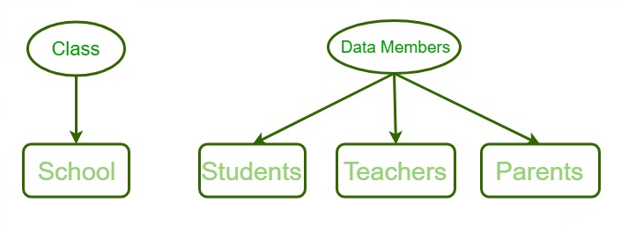
A class is an expanded concept of data structures.
It defines a prototype blueprint of objects comprising of data. And an object is an instance of a class.
A class comprises of the data members and data functions and it is a pre-defined data type made as per the user’s requirements which can be accessed and used by creating an instance of that class.

Slide 6

It is very easy to define a class in Perl.
In Perl, a Class corresponds to a package.
To define a class we first load and build a Package.
A Package is a pre-contained unit of user-defined variables and subroutines, which can be used throughout the program.
Syntax:
package Class_name

Slide 7
A class in Perl can be created by using the keyword package but to create an object, a constructor is called.
A constructor is defined in a class as a method.
Creating an instance of a class
A class name and a constructor name can be as per user’s requirement.
Most of the programmers prefer to use ‘new’ as a constructor name for their programs as it is easy to remember and is more feasible to use than any other complex constructor name.

Slide 8
package student // This is the class student
sub Student_data // Constructor to class
{
my $class = shift;
my $self = {
-StudentFirstName => shift;
-StudentLastName => shift;
};
print "Student's First Name is $self ->{_StudentFirstName}\n";
print "Student's Last Name is $self ->{_StudentLastName}\n";
bless $self, $class;
return $self;
}

Slide 9
Methods are the entities that are used to access and modify the data of an object. A method is a collection of statements that perform some specific task and returns a result to the caller. A method can perform some specific task without returning anything. Methods are time savers and help us to reuse the code without retyping the code.
sub Student_data
{
my $self = shift;
# Calculating the result
my $result = $self->{'Marks_obtained'} /
$self->{'Total_marks'};
print "Marks scored by the student are: $result";
}

Slide 10
Based on the arguments passed, methods can be classified into two types- static method and virtual method.\
A static method is one in which the first argument passed to the method is the class name. Functionalities of a static method are applied to the whole class because it takes the name of the class as an argument. These methods are also called class methods. Since most of the methods are in the same class and hence, there is no need to pass the class name as an argument.
Example: Constructors of a class are considered to be static methods.
A virtual method is one in which the reference to the object is passed as the first argument to the function. In a virtual function, the first argument is shifted to a local variable and then this value is used as a reference.

Slide 11
get-set Methods:
Methods are used to provide security to the object’s data and hence used with either the object’s reference or the value is stored in some other variable and then used. get-set methods are used in the OOPs to provide this data security to the objects. get-method helps to get the current value of the object and the set value method is used to set a new value to the object.

Slide 12

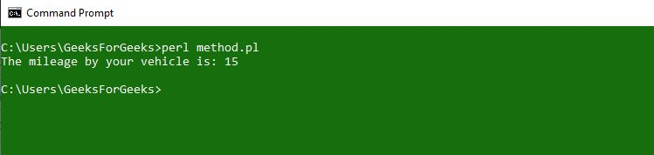
# Declaration and definition of Base class
use strict;
use warnings;
# Creating parent class
package vehicle;
# Setter method
sub set_mileage
{
# shift will take package name 'vehicle'
# and assign it to variable 'class'
my $class = shift;
my $self = {
'distance'=> shift,
'petrol_consumed'=> shift
};
# Bless function to bind object to class
bless $self, $class;
# returning object from constructor
return $self;
}
# Getter method
sub get_mileage
{
my $self = shift;
# Calculating result
my $result = $self->{'distance'} /
$self->{'petrol_consumed'};
print "The mileage by your vehicle is: $result\n";
}
# Object creation and method calling
my $ob1 = vehicle -> set_mileage(2550, 170);
$ob1->get_mileage();

Slide 13

Polymorphism is the ability of any data to be processed in more than one form. The word itself indicates the meaning as poly means many and morphism means types.
Polymorphism is one of the most important concept of object oriented programming language.
The most common use of polymorphism in object-oriented programming occurs when a parent class reference is used to refer to a child class object. Here we will see how to represent any function in many types and many forms.

Slide 14
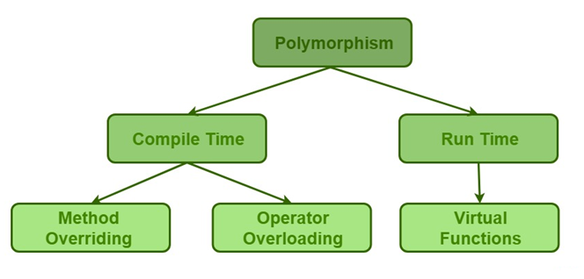

Slide 15
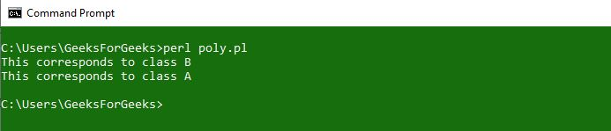
package B;
# The @ISA array contains a list
# of that class's parent classes, if any
my @ISA = (A);
sub poly_example
{
print("This corresponds to class B\n");
}
package main;
B->poly_example();
A->poly_example();
use warnings;
# Creating class using package
package A;
# Constructor creation
sub new
{
# shift will take package name 'vehicle'
# and assign it to variable 'class'
my $class = shift;
my $self = {
'name' => shift,
'roll_no' => shift
};
sub poly_example
{
print("This corresponds to class A\n");
}
};

Slide 16

Inheritance is the ability of any class to extract and use features of other classes. It is the process by which new classes called the derived classes are created from existing classes called Base classes. The basic concept here is that the programmer is able to use the features of one class into another without declaring or defining the same thing again and again in different classes. Instead of writing the member functions during every class declaration we can inherit those from the base class. Inheritance is one of the most important feature of Object Oriented Programming.
Sub Class: The class that inherits properties from another class is called Sub class or Derived Class.
Super Class: The class whose properties are inherited by sub class is called Base Class or Super class

Slide 17

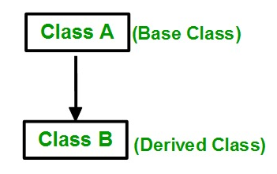
Base class is used to derive additional inherited subclasses known as Derived classes. There can be multiple derived classes from a single base class, such type of inheritance is called Hierarchical Inheritance.
These derived classes share a single Parent class or Base class. If a derived class shares multiple Parent classes and inherit its features from multiple parent classes then such kind of inheritance is called Multiple Inheritance.

Slide 18
THANK YOU

